Slide 1
Angular HttpClient Observables and Forms
Vignesh Murali Natarajan - 119780
Jason Monroe - 688776

Slide 2
Course Objective:
At the end this 90 min session, you will be able to
Make GET and POST requests with HttpClient
Subscribe to an Observable
Create a Reactive Form
Create a custom validator

Slide 3
Benefits
HttpClient exposes http verbs for making REST calls
Observables handle asynchronous method calls
Reactive Forms handle user input and are testable

Slide 4

Objectives
In this session we will be covering the following topics:
HttpClient
Introduction
Observables
Subscriptions
Get() and Post()
Forms
Introduction
Template Driven Forms
Model Driven Forms
Form Validation

Slide 5
HttpClient

Slide 6
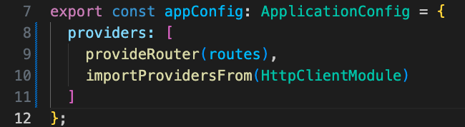
HttpClient Service
HTTP calls from an application can be made through the HttpClient service that belongs to @angular/common/http module. THIS IS MAY NOT THE DEFAULT IMPORT IN VISUAL STUDIO CODE!!!
It supports both XHR and JSONP requests exposed through the HttpModule and JsonpModule respectively.
The HttpClient service exposes methods for every HTTP method – get(), put(), delete(), post() etc. All of these methods return Observables.
HttpClient is a built-in service and should be inserted using Dependency Injection to the components in need. It must also be added as an import to the app.module.ts components in Angular <v17 or added to app.config.ts using importProvidersFrom(HttpClientModule) pictured here:
Notes:
Angular provides a module for handling all Http requests. Import this module and inject the HttpClient service into any Component or service that you would like to make REST calls from. Typically, we organize our Http requests by services related to that data.

Slide 7
Observables
Observables are mechanisms to open a continuous channel of communication between two components, in which multiple values of data can be emitted over time to all subscribers.
This is a pattern of dealing with data by using array-like operations to parse, modify and maintain data.
Observables are not Angular specific features, rather a proposed standard for managing asynchronous data that was included in ES7.
Observables belong to RxJs Module and needs to be imported accordingly.
Notes:
Observables are powerful objects that allow us to manage asynchronous communication throughout our application. They can publish information that subscribers can receive.

Slide 8
Subscription
Observables Subscription:
Observables can be listened-to using the following methods:
subscribe – This method accepts three callback functions in the below order:
Progress callback – it is called every time the observable posts a new value.
Error callback – It is called when the observable posts an error.
Completion callback – It is called when the observable signals successful completion.
foreach – This method is a wrapper around the subscribe method, returning a promise object. The promise is resolved or rejected based on success or failure respectively.
Notes:
When you call a function that returns an observable, you subscribe to it, supplying a call-back function. When the observable broadcasts new information, the call-back function will be executed. You can also supply call-back functions to be executed on error and on completion.

Slide 9
Subscription (Contd.)
Observables Subscription using subscribe:
<<method call that returns an Observable>>.subscribe({
next: (data) => {},
error: (error) => {},
complete:(data) => {}
});
In the Observer, initiating an unsubscribe:
data.unsubscribe();
Notes:
The top picture illustrates making a call to a function that returns an Observable. The subscribe method is being called on this Observable and is supplying an object with properties. The Next property is the call-back function that get executes anytime the Observable broadcasts new information with its next() function. If an error occurs, the observable can notify the observer / subscriber by calling the error function. This would invoke the function supplied by the error property in the pictured object. Finally, Observables can notify subscribers / observers when the Observable is done broadcasting completely. They do this by executing their complete function. This, in turn, would invoke the function supplied by the complete property in the object sent by each subscriber.
Observables may also be unsubscribed to, in which case, all of the functions that were supplied originally by the subscribe function would be deregistered with the Observable and no longer executed.

Slide 10
Un-subscribe
Observable subscription objects support an unsubscribe method to cancel subscription, when invoked.
While “unsubscribe” is typically triggered from the subscribers, the observable can also react by using the “onUnsubscribe” method.
Observables may return an “onUnsubscribe” function, detailing what needs to be done at the observable’s end when a subscriber unsubscribes.
Notes:
(previous slide notes should suffice for this slide)

Slide 11
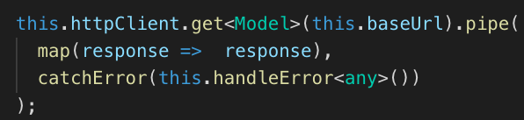
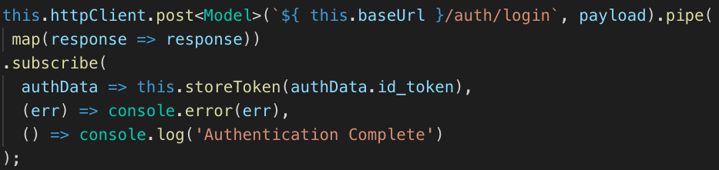
HttpClient Service
An HttpClient get request sends a url. The pipe method is used to ‘stitch together functional operators into a chain’
catchError and map methods shown above must be imported from rxjs/operators
Below invocation posts a http request and reacts using the subscribe method callbacks – Progress, Error and Completion.
Notes:
The HttpClient service exposes get, post, put and delete functions for making REST calls. The function call may include generics which are the angle brackets and the data type enclosed within it. This instructs the method as to what type of data it should serialize and deserialize in its requests. In regular JavaScript, this is done with JSON.stringify() and .json() functions. This is all taken care of within these HTTP request methods.

Slide 12

Video Demo – DeveloperBios-API Setup
Download and unzip the DeveloperBios-API.zip file.
Open in Visual Studio Code or your favorite JavaScript IDE
In the terminal, run npm install
Run npm start
Test http://localhost:3000/developers/all
If you have Postman or another API testing tool that can make POST requests, test http://localhost:3000/developers/save
Notes:
This demo shows how to get the backend server up and running to support our next Angular feature.

Slide 13
Video Demo – HttpClient and Observables
Update the DeveloperService to retrieve the live data from an API
Import HttpClient, Observable, catchError, and map.
Inject HttpClient in constructor and delete ‘hard coded’ developers
Change the return type of the getAllDevelopers() method to Observable<Developer[]>
url is http://localhost/developers/all
getDeveloperById must be updated now that devs isn’t defined in the constructor.
Use http.get with the above url and return the response
Add HttpClientModule import in app.config.ts
Subscribe to the getAllDevelopers() method in the bio.component.ts call and add HttpClientModule to imports
Notes:
For this Demo, you will need the DeveloperBios-API application up and running on your local machine. This should be provided for you in the materials and a video demo is available to get you started with it.

Slide 14
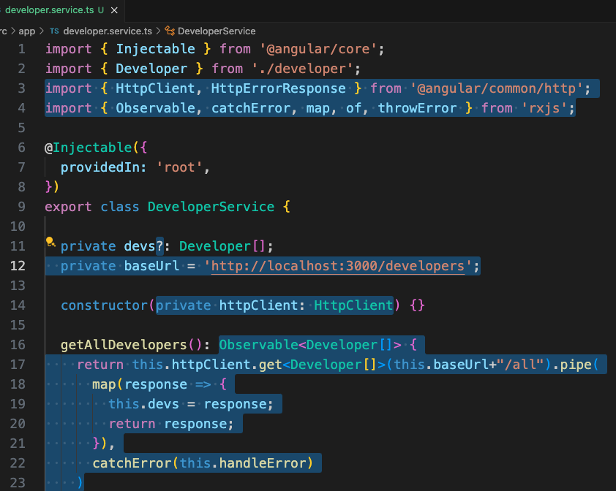
Video Demo – HttpClient and Observables
#1
Notes:
Instructions to Trainer:
Instructions to Facilitator:

Slide 15
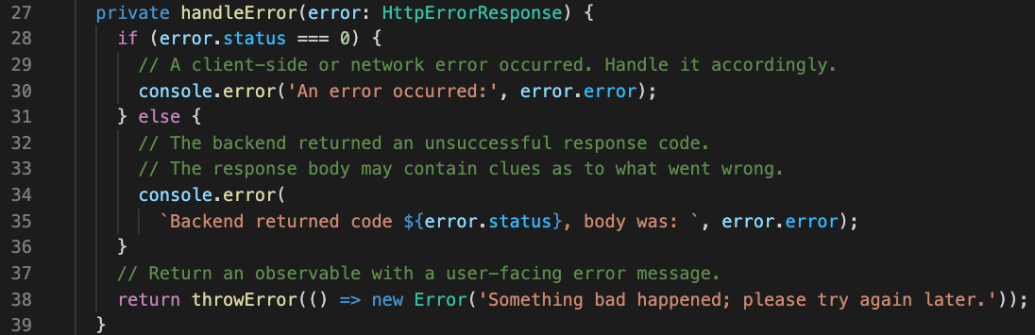
Video Demo – HttpClient and Observables
https://angular.io/guide/http-handle-request-errors
Notes:
Instructions to Trainer:
Instructions to Facilitator:

Slide 16
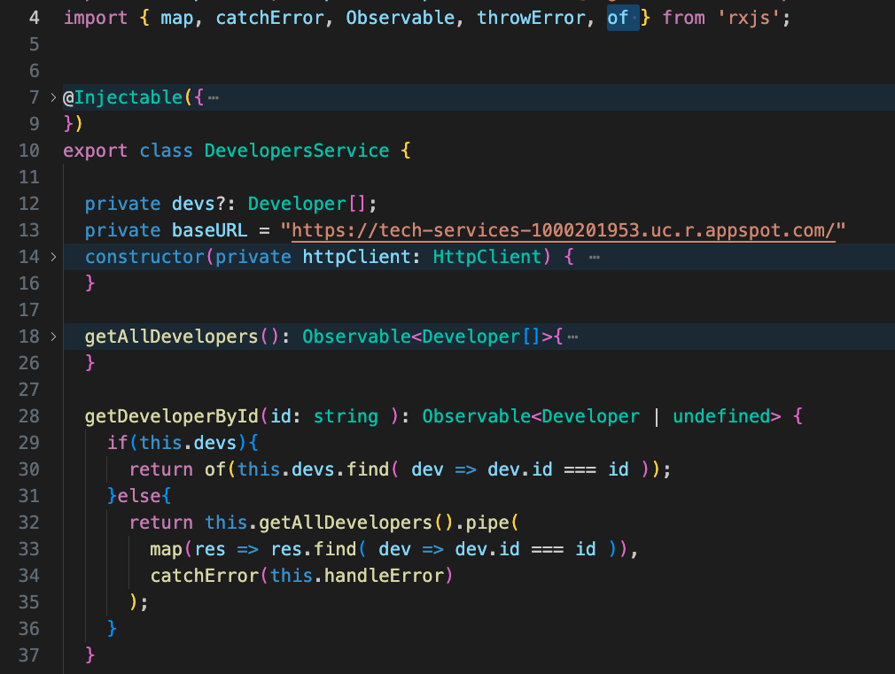
Video Demo – HttpClient and Observables
https://angular.io/guide/rx-library
Get dev by id from local if exists, otherwise make REST call. Of function converts to observable
Notes:
Instructions to Trainer:
Instructions to Facilitator:

Slide 17
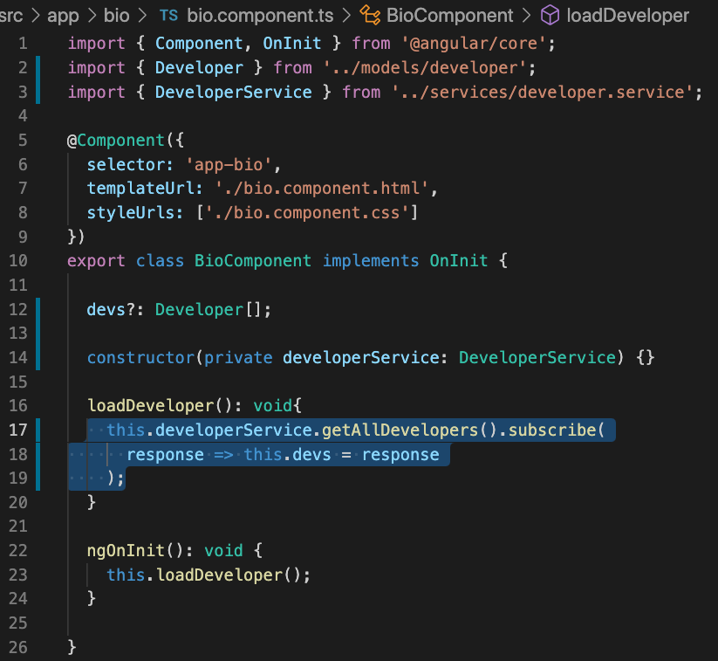
Video Demo – HttpClient and Observables
#2

Slide 18
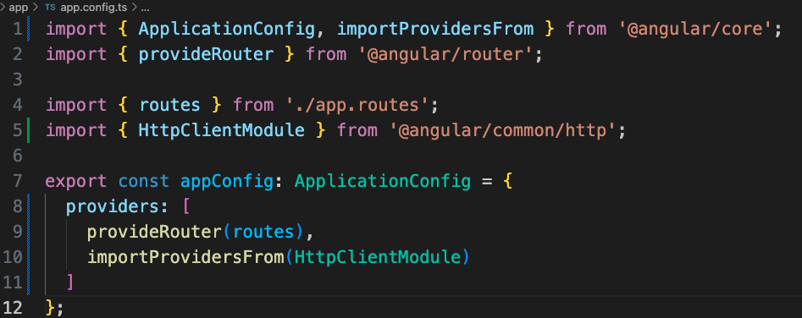
Video Demo – HttpClient and Observables
Notes:
Instructions to Trainer:
Instructions to Facilitator:

Slide 19
Forms

Slide 20
Introducing Forms
Angular gives degrees of simplicity and power, depending on the form's purpose, when it comes to Form Support. The following types of Form handling are supported:
Template-Drive: HTML 5 with no JavaScript
Two-way binding: Forms place form handling logic within a component's class properties and provides interaction through observables
ReactiveFormsModule: all of the tools for complex forms and validation
Notes:
There are several ways to build Forms within Angular. HTML 5 is completely capable of sending form data without the help of javascript at all. This doesn’t allow us to create our own validation and unit test the forms, however. We could also us two-way binding with ngModel to capture the inputs that users supply in a form, then make our httpReqests. There is another mechanism within Angular, though, that developers use to build complex forms, and that is by using the ReactiveFormsModule

Slide 21
Reactive Forms
Reactive forms lets definition of forms through code and gives more flexibility and control over data validation.
Reactive forms enables unit testing without relying on end-to-end tests like Template Driven Forms does.
Reactive forms are driven by components, directives, and providers like FormBuilder, FormGroup, and FormControl.
To create model-driven forms, create a form model that represents that DOM structure in the component.
ReactiveFormsModule must be imported into app.module.ts (Angular<17) or each standalone component that has a form (Angular >= 17)

Slide 22
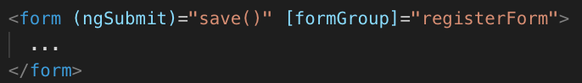
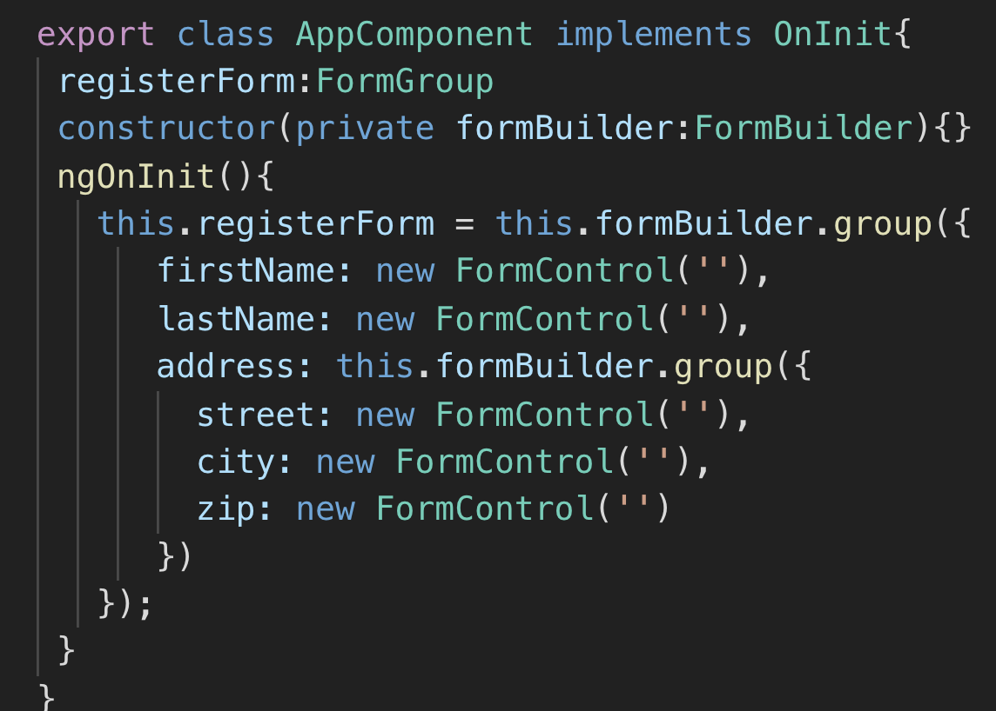
Reactive Forms
formGroup To tell Angular that a form model is responsible for the corresponding form template, the formGroup directive can be used. The formGroup takes an expression that evaluates to a FormGroup instance.
ngSubmit The method in the Component that gets called on submit
FormBuilder is a factory that creates FormGroup’s and FormControl’s for you. All you need to do is to import it and use its .group() method.
Notes:
To build a Form using the Reactive Forms approach, you start by creating a form tag with an ngSubmit event binding and a form group property binding. The event binding should be to a function in the component that you want to use to submit the form, and the form group property binding should be bound to a form group object. We can build a form group object in our component by using the formBuilder class as pictured in the second image. Call the group function that is exposed by the form builder instance that we injected into the constructor. Pass the group function an object that has properties for every form input element. Set them to an instance of a new FormControl() object.
You can also have nested groups. Pictured here, you can see that the address has a nested form group object that contains street, city and zip.

Slide 23
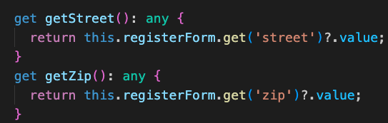
Reactive Forms
formControlName is used to associate a group of form controls to its model
To access the form input elements and their values in your component, pass the formControlName value into the get function that is exposed by the formGroup object
Notes:
Each form input element should have a formControlName property that is set to the property name set up in the object that was passed into the group function (pictured on previous slide). To retrieve the form data, you use the get function exposed by the formGroup object . Pass it the name of the form control object that you want to access. Use the value property to access the value. Pictured here, you can see that we have wrapped this get function call in a function that we have also exposed as a component property using the get keyword.

Slide 24
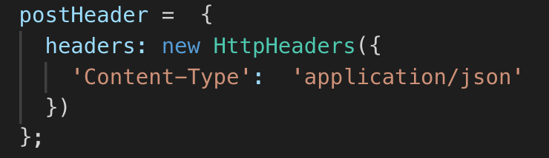
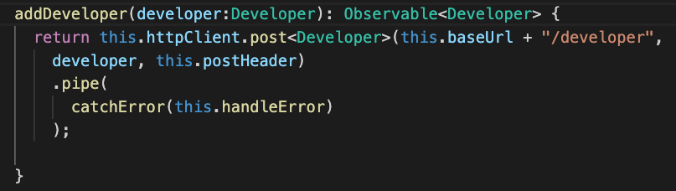
HttpClient Post
Most POST endpoints require the header ‘Content-Type’ : ‘application/json’ to be present
Notes:
The post request form httpClient is similar to the get request, except it takes 2 more arguments. The body of the request can be added as the second argument and the third argument is where you can pass any headers that the request might need.

Slide 25
Video Demo – Add Developer Form
Create a new component called BioCreate (ng g component BioCreate).
Add a route to this component in your app.routes.ts
Add a link to this component in your nav bar (app.component.html)
Create a reactive form in the bio-create component that will create a new developer bio.
Create the form with (ngSubmit)=saveDeveloper() and [formGroup]=“devForm”. Use these formControlName values: firstName, lastName, favoriteLanguage, yearStarted
In the bio-create.component.ts:
Add FormsModule and ReactiveFormsModule to imports array in @Component decorator
Import FormGroup, Router, FormBuilder, Validators, and DeveloperService.
Create a member variable called devForm to match the formGroup name above and set it equal to a new form group containing all the inputs.
Create get methods for accessing the form values
Inject Router, FormBuilder, developerService
Create the saveDeveloper() method that is being called from (ngSubmit). It should create a Developer object and then send that object to developerService.postDeveloper(dev: Developer). Navigate back to /bio using this.router.navigate().
Write the postDeveloper method to post the form data to http://localhost:3000/developers/save. It will require Content-Type: application/json.
header

Slide 26
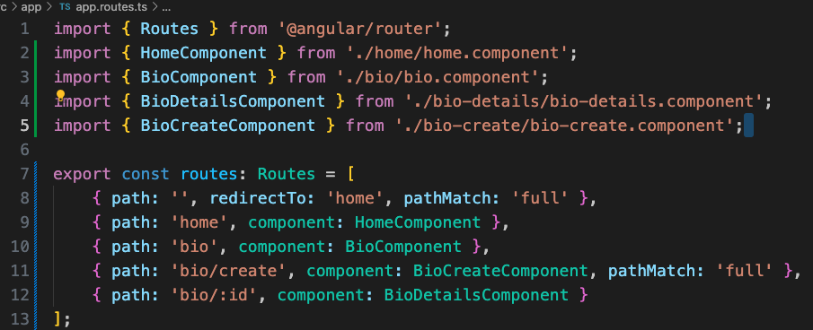
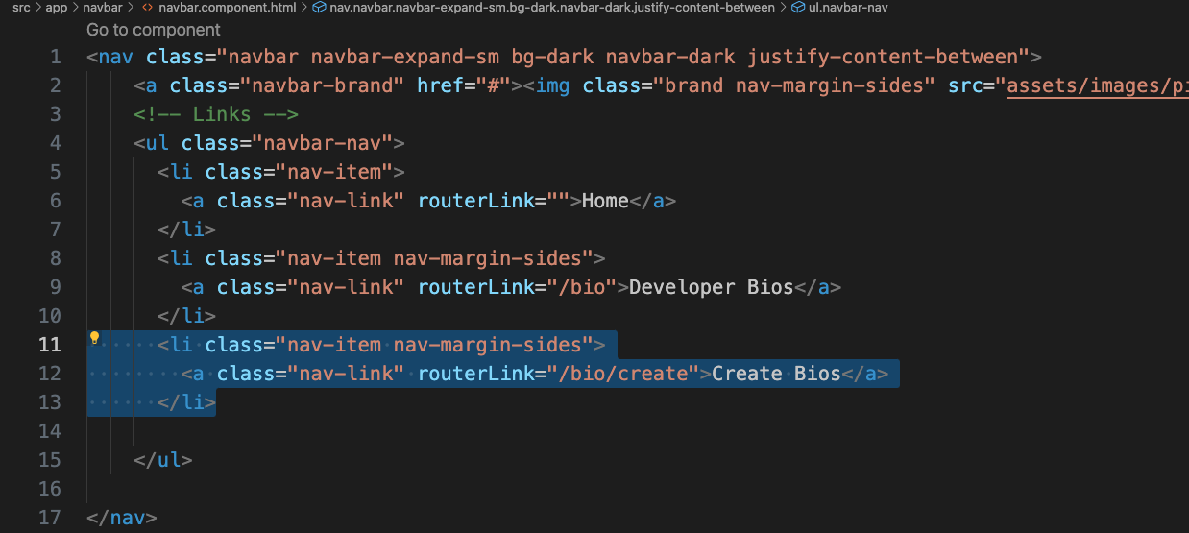
Video Demo – Add Developer Form
#1 a
#1 b
Notes:
Instructions to Trainer:
Instructions to Facilitator:

Slide 27
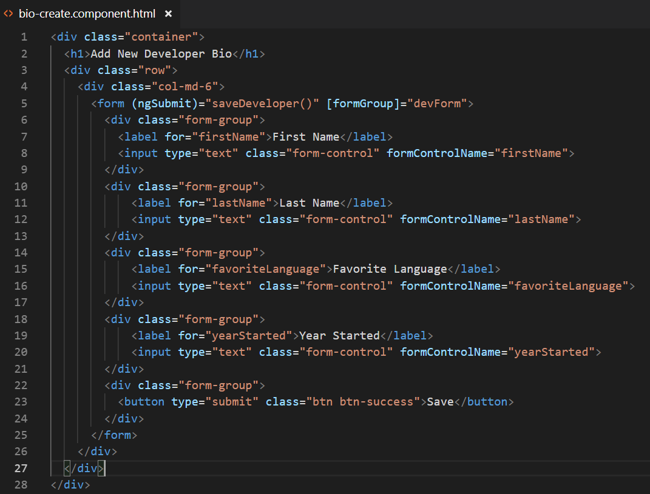
Video Demo – Add Developer Form
#2 a ->
Notes:
Instructions to Trainer:
Instructions to Facilitator:

Slide 28
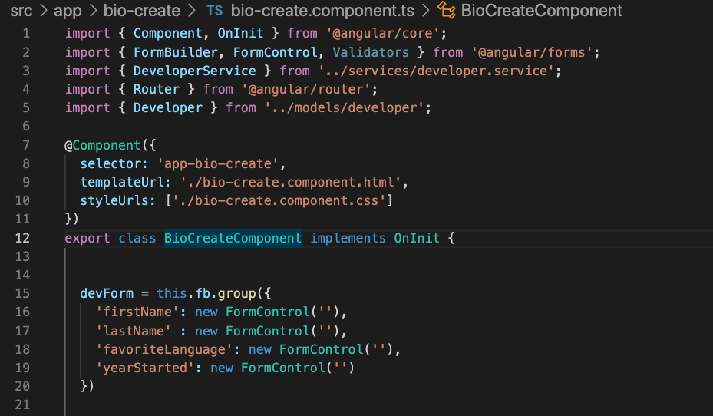
Video Demo – Add Developer Form
#2 b 1-3
Notes:
Instructions to Trainer:
Instructions to Facilitator:

Slide 29
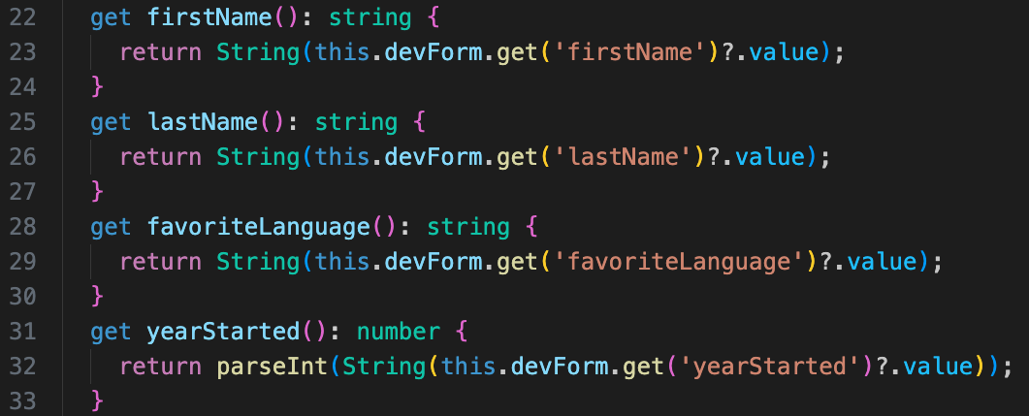
Video Demo – Add Developer Form
#2 b 4
Notes:
Instructions to Trainer:
Instructions to Facilitator:

Slide 30
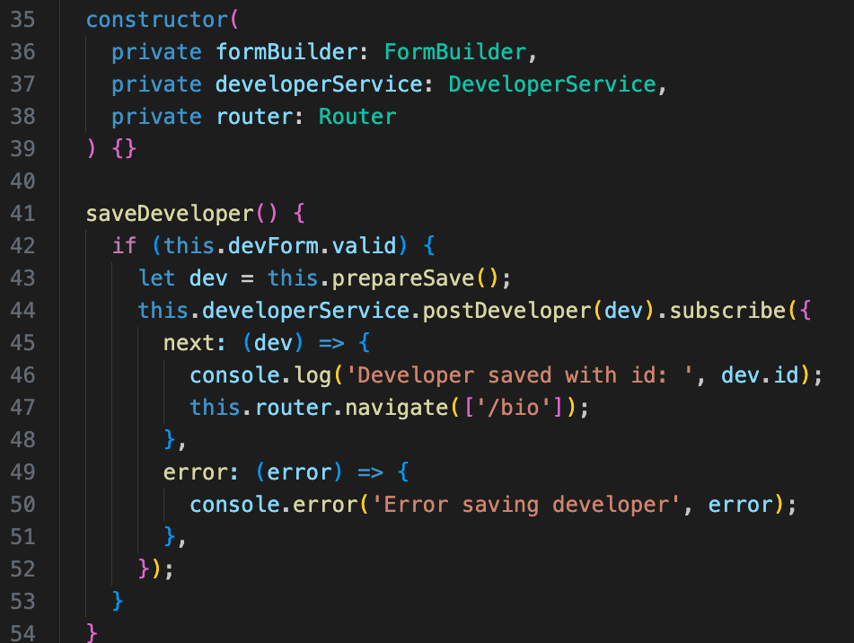
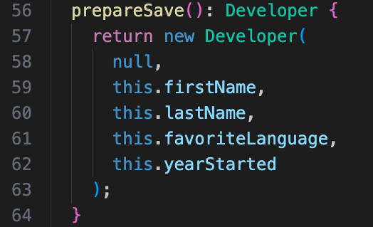
Video Demo – Add Developer Form
#2 b 5,6
Notes:
Instructions to Trainer:
Instructions to Facilitator:

Slide 31
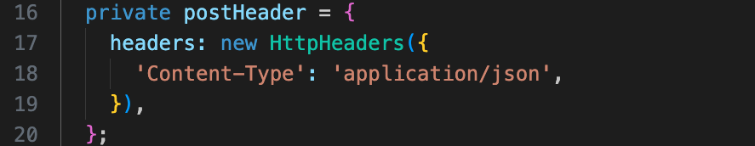
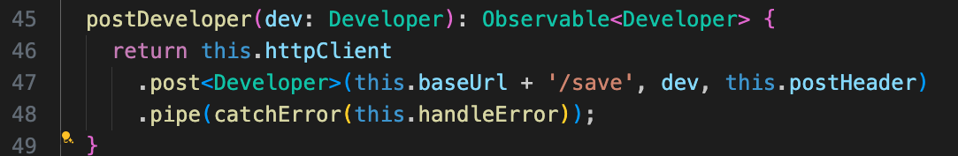
Video Demo – Add Developer Form
#3 developer.service.ts
Notes:
Instructions to Trainer:
Instructions to Facilitator:

Slide 32
Form Validation

Slide 33
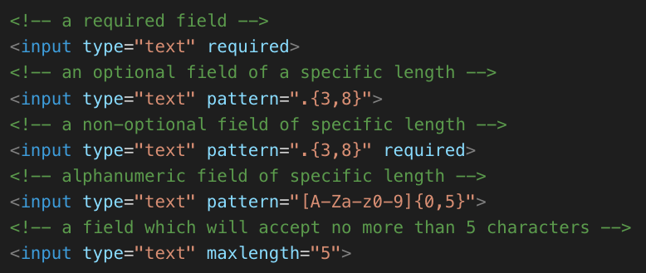
Form Validation – Built-in
Template-driven forms are validated using HTML5 validators.
Model-driven forms can be validated by Angular’s built-in validators. List them in an array as the second argument in the FormControl constructor
Notes:
HTML 5 is capable of form validation on its own, without JavaScipt assistance. However, we would not be able to unit test this validation. This is another reason why Reactive Forms is the best practice. We can add validation to any form element by passing a validator in an array as the second argument in the FormControl constructor. Angular supplys a Validators class with many pre-build validations ready to use. Pictured in the second image, you can see that the street field and the zip field have a required validation. In addition, the zip field also has a max length validation of 5 characters.

Slide 34
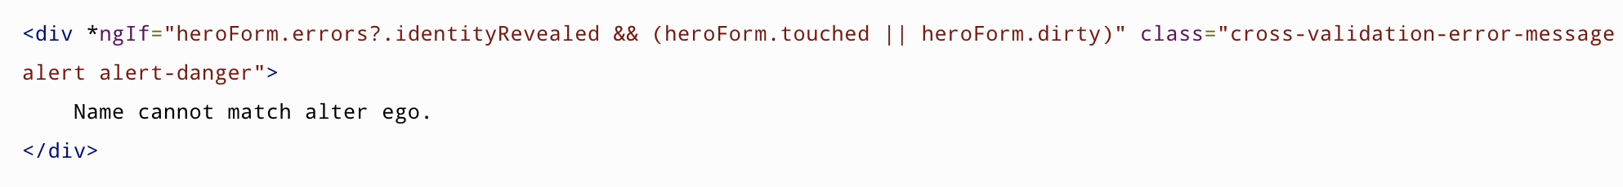
Form Validation – Model Driven
Validators will be checked on page load as well as every time the change event is triggered for the input element
In order to inform the user that something is invalid, you must create a span or div that displays this info
This info can be found in the FormGroup object or each individual form control
To avoid having these messages displayed on page load, you can check to see if the form or individual control is ‘dirty’
https://angular.io/guide/form-validation
Notes:
Check the Angular.io guide link provided to find out more about form validation.

Slide 35
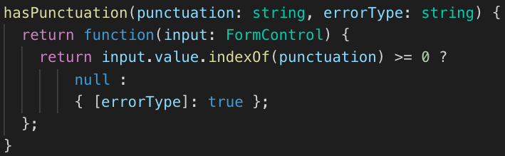
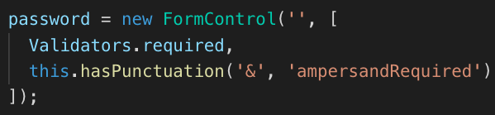
Form Validation – Model Driven Custom
It is very useful to be able to include custom validators that suit adhoc functional needs. To use custom validators, define the validation function in the component. Function can receive parameters related to validation including errorType as a string
Returns either null or an object with errorType property set to true
Registering the validator for a field
Notes:
We can also create custom form validation with Reactive forms. Here you can see that a hasPunctuation function is being used as a validator in the password field. Any function can be a form validation function as long as it returns a function that will either return null if the form is valid or else an object with an error property. This property can be named anything, but must have the value set to true.

Slide 36
Video Demo – Custom Validation
Write a function called isValidYear that checks to see if the yearStarted field in the Create Bio form is an integer and is more recent than 1960.
Function should receive a parameter for minYear and the errorType string
Function should return either null if it is valid or return an error object
Add the function to the Validations array
Create a div that displays an invalid year message when the user’s input is invalid and the yearStarted field has been touched
Prohibit the form from submitting if the form is invalid
Notes:
Instructions to Trainer:
Instructions to Facilitator:

Slide 37
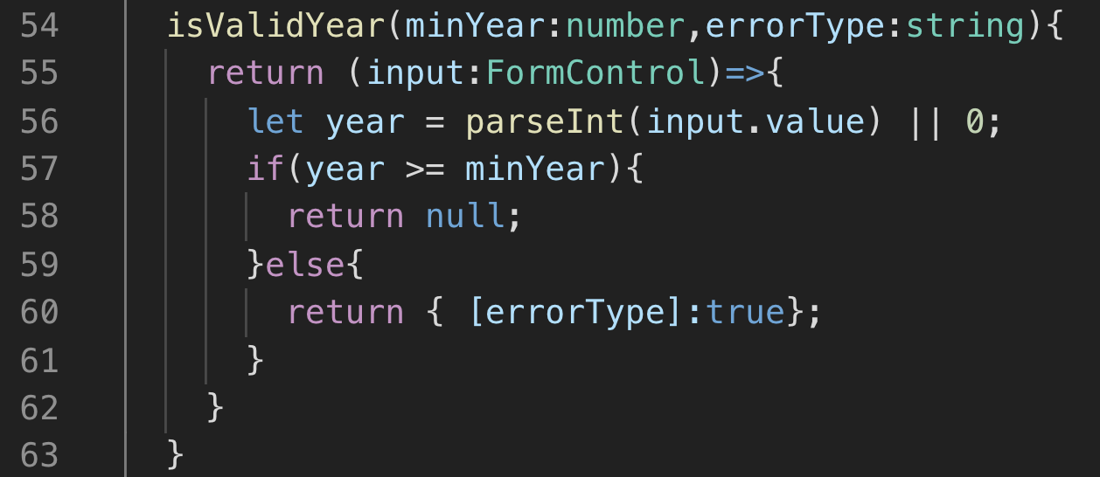
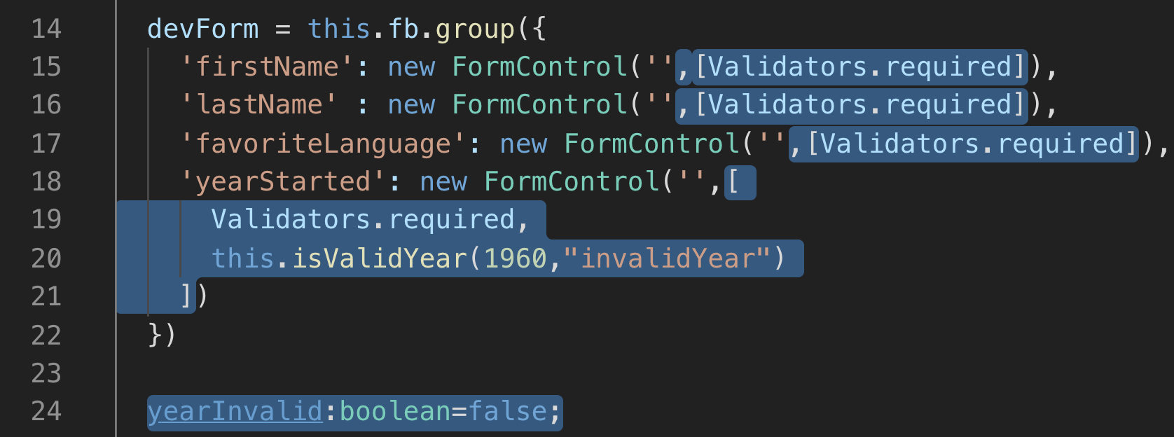
Video Demo – Custom Validation
#1
#2
Notes:
Instructions to Trainer:
Instructions to Facilitator:

Slide 38
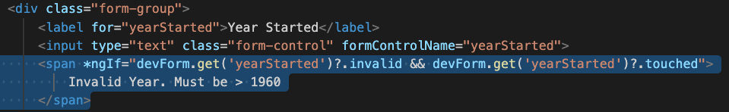
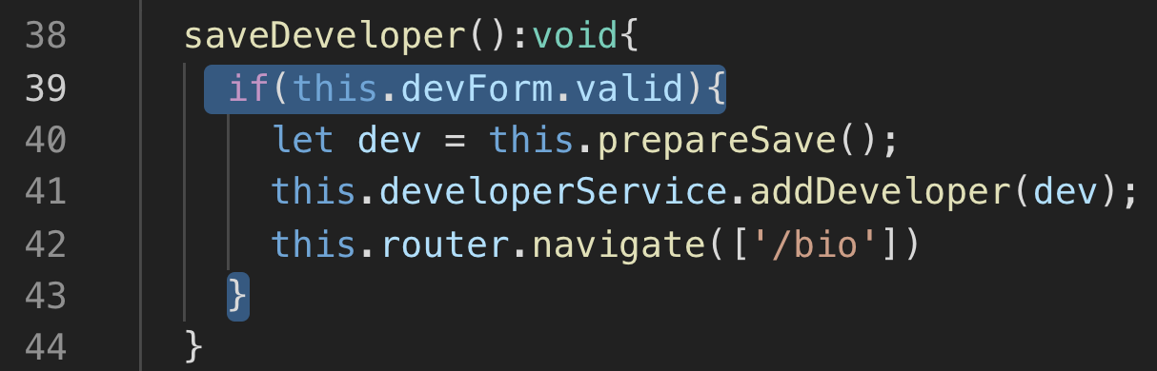
Video Demo – Custom Validation
#3
#4

Slide 39
Review
Forms
Template Driven
Reactive (Model Driven)
formGroup
ngSubmit
formControlName
HttpClient
GET, POST, PUT, DELETE
DI
Subscribe to Observable
Validation
Passed in array in FormControl constructor
Any function can be custom validator as long as it:
returns null or object with error

Slide 40
Course Objective:
At the end this 90 min session, you will be able to
Make GET and POST requests with HttpClient
Subscribe to an Observable
Create a Reactive Form
Create a custom validator

Slide 41
Explain the steps to make an HttpClient get call in Angular ?
What are the different types of Forms?
What are the advantages of Model Driven Forms?

Slide 42
Thank you
Vignesh Murali Natarajan - 119780
Jason Monroe - 688776

